Slide 1
Local Search Algorithms Hill Climbing Search, Simulated Annealing

Slide 2
Local Search Algorithms
PERFORM PURELY LOCAL SEARCH IN THE STATE SPACE,
EVALUATING AND MODIFYING ONE OR MORE CURRENT STATES RATHER THAN SYSTEMATICALLY EXPLORING PATHS FROM AN INITIAL STATE.
FOCUSSES MORE ON REACHING THE GOAL STATE RATHER THAN ON THE PATH COST
SUITABLE FOR OPTIMISATION PROBLEMS
OPTIMISATION FUNCTION – STATE-SPACE LANDSCAPE WITH LOCAL AND GLOBAL MINIMA AND MAXIMA
ADVANTAGES
They use very little memory—usually a constant amount
They can often find reasonable solutions in large or infinite (continuous) state spaces for which systematic algorithms are unsuitable.
EXAMPLES
PROBLEMS - integrated-circuit design, factory-floor layout, job-shop scheduling, automatic programming, telecommunications network optimization, vehicle routing, and portfolio management.
Algorithms - HILL CLIMBING SEARCH, GENETIC ALGORITHM, SIMULATED ANNEALING

Slide 3
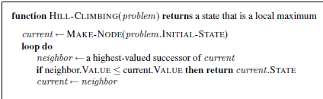
Hill Climbing Search (Steepest – Ascent version)
Also called Greedy Search
Hill climbing = generate and test + heuristics

Slide 4
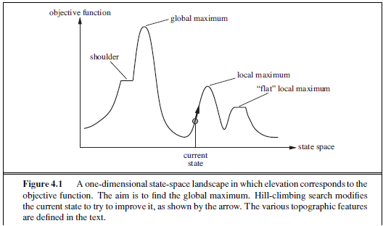

Slide 5
Limitations
Hill climbing cannot reach the optimal/best state (global maximum) if it enters one of the following regions:
Local maximum:
a peak that is higher than each of its neighboring states but lower than the global maximum.
Hill-climbing algorithms that reach the vicinity of a local maximum will be drawn upward toward the peak but will then be stuck with nowhere else to go.
Plateaus
a flat area of the state-space landscape. It can be a flat local SHOULDER maximum, from which no uphill exit exists, or a shoulder, from which progress is A hill-climbing search might get lost on the plateau.
Ridges
Ridges result in a sequence of local maxima that is very difficult for greedy algorithms to navigate.

Slide 6
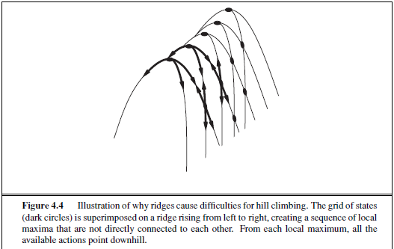

Slide 7
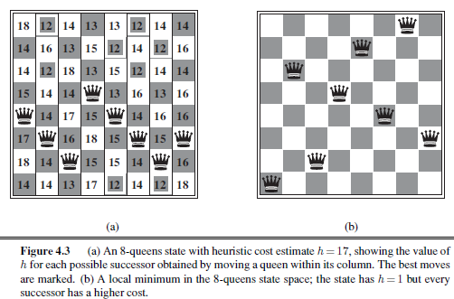
Example – Local Maximum

Slide 8
Performance of Steepest Ascent Hill Climbing
For 8-queens with a random initial board with 8 queens and a optimisation function/heuristic function – number of non attacking queens – the algorithm gets stuck 86 percent of time (14%success)
Hill Climbing algorithm – halts on encountering a plateau
Solution of challenge by plateau
Allowing sideways move (successor state with same value as the current state)
Drawback – Infinite loop on a flat local maxima.
Solution – Limit of the consecutive sideways moves
With the solution – success percent raised to 94% (21 steps for successful instance and 64 moves for failure instances)

Slide 9
Variants of hill climbing
Incomplete algorithms
Stochastic hill climbing
Chooses at random from among the uphill moves; the probability of selection can vary with the steepness of the uphill move. This usually converges more slowly than steepest ascent, but in some state landscapes, it finds better solutions.
First-choice hill climbing
Implements stochastic hill climbing by generating successors randomly until one is generated that is better than the current state. This is a good strategy when a state has many (e.g., thousands) of successors

Slide 10
Variants of Hill Climbing contd…
Random restart Hill Climbing
Conducts a series of hill-climbing searches from randomly generated initial states, until a goal is found.
Trivially complete – eventually generating a goal node as the initial state

Slide 11
Success Rate Vs State-space Landscape
Few local maxima and plateaux, random-restart hill climbing will find a good solution very quickly.
Real problems have a landscape have an exponential number of local maxima to get stuck on. Despite this, a reasonably good local maximum can often be found after a small number of restarts.

Slide 12
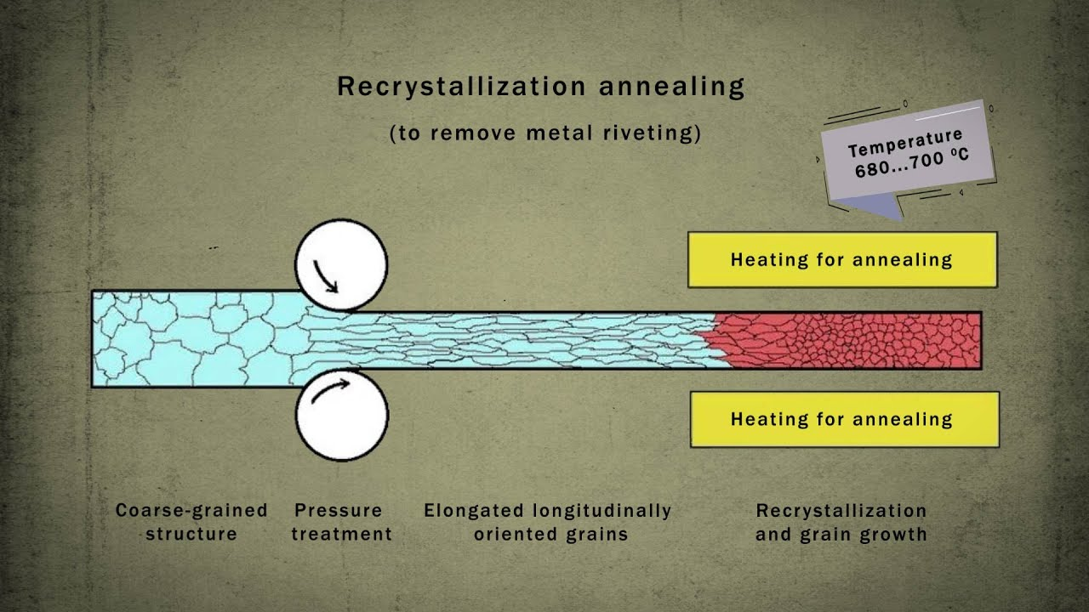
Simulated Annealing
Combination of random walk and hill climbing (Random walk – choosing a successor states uniformly at random)
Annealing - process used to temper or harden metals and glass by heating them to a high temperature and then gradually cooling them where they reach a low energy crystalline state

Slide 13
